Slide 1

HEY
WAKE UP!
VITO
RAY
Coursedesign_Ⅲ
DESIGNED BY IBOTU
DESIGNED BY IBOTU
A SIMPLE AND NICE TEMPLATE HOPE YOU LIKE BY VITO RAY
12119370118_何振宇
DO SOME
THINGS!

Slide 2
Design ideas
HEY
WAKE UP!
VITO
RAY
1. Data collection and preparation stage:
Collect movie data: Get movie data including movie title, actors, director, genre, rating, etc. from various sources like IMDb, The Movie Database, etc.
User behavior data: Collect user behavior data such as movie ratings, collections, and viewing history.
2. Data storage and processing:
Database design: Create a database model to store movie information, user information, and user rating data for movies.
Data preprocessing: Clean and transform movie data, and deal with issues such as missing values and duplicate values.
3. Collaborative filtering algorithm selection:
Select algorithm: Choose a suitable collaborative filtering algorithm (such as user-based collaborative filtering (UserCF), item-based collaborative filtering (ItemCF)), or even a hybrid recommendation system that uses a mix of multiple algorithms.
Algorithm optimization: For large-scale data sets, consider algorithm performance optimization, sparsity processing, etc.
4. System architecture design:
Backend Architecture: Use Django framework to build backend services to handle user requests, data storage and processing.
Front-end design: Use the bootstrap framework to design the user interface, including functions such as displaying movie information and user personalized recommendations.
DESIGNED BY IBOTU
DESIGNED BY IBOTU
DO SOME
THINGS!

Slide 3
Design ideas
HEY
WAKE UP!
VITO
RAY
5. Implement recommendation system:
Model training: Train recommendation models based on collected user behavior data.
Recommendation service: Implement a recommendation service based on collaborative filtering, recommending similar users or similar items based on the user's historical behavior or interests.
6. User interaction and personalized recommendations:
User interaction interface: realizes functions such as user registration, login, movie browsing, and viewing personal recommendations.
Personalized recommendation: Implement personalized recommendation function based on the user's historical behavior and preferences.
7. Testing and optimization:
System testing: Carry out functional testing, performance testing and user experience testing on the system.
DESIGNED BY IBOTU
DESIGNED BY IBOTU
DO SOME
THINGS!

Slide 4
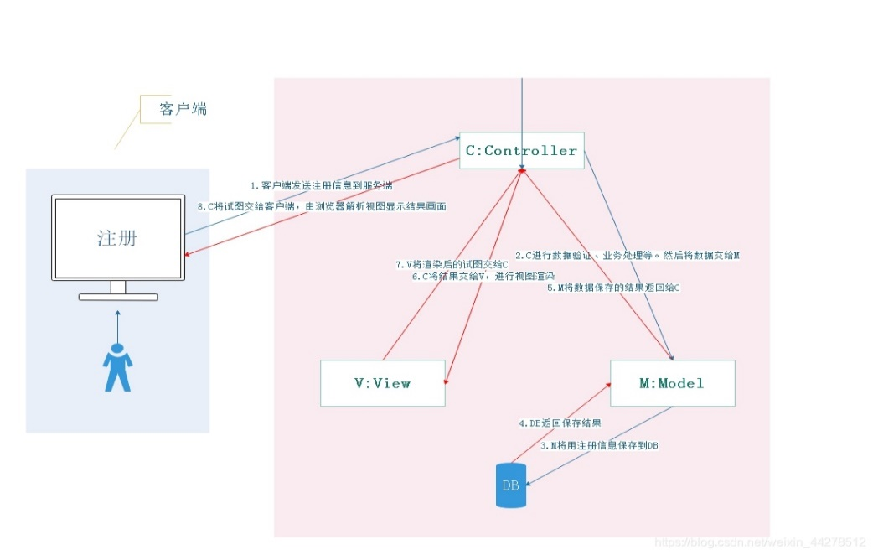
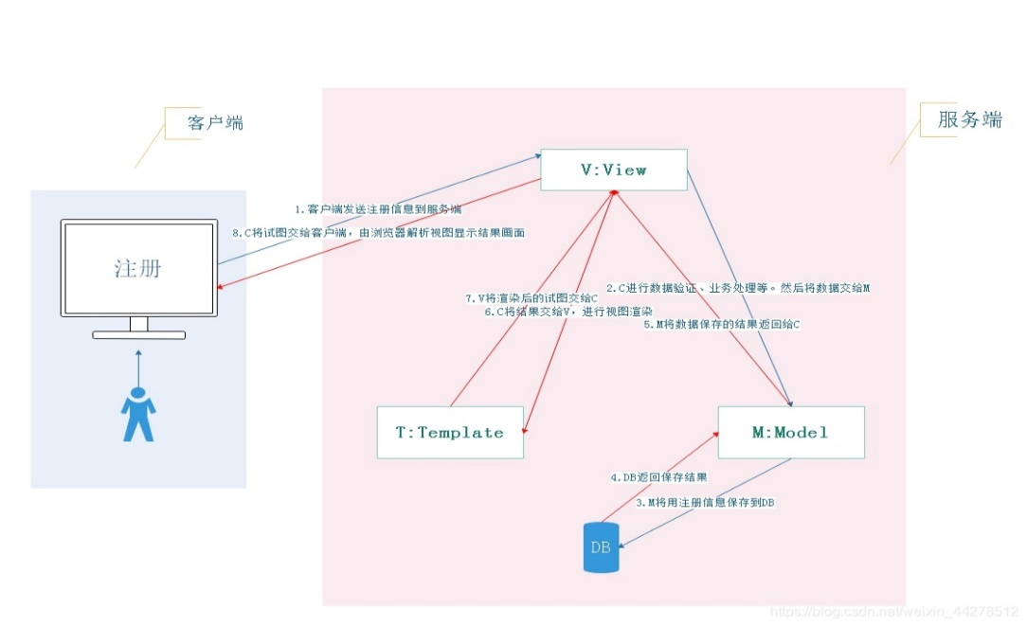
django
HEY
WAKE UP!
VITO
MVT(Model-View-Template)(Django) M(Model): Equivalent to MVC's M, which encapsulates the operation process of the database(connecting to the database, adding, deleting, modifying, and checking data) V(View): Equivalent to MVC's C, encapsulates the result data, renders the page, and generates the page content(html) for display to the user. T(Template): equivalent to the V of MVC, encapsulates receiving requests, processing requests(business processing), responding to requests, and Model, Template interaction process.
————————————————
MVC(Model-View-Controller), it is a design pattern and a framework model. Core: High cohesion and low coupling, enhanced code scalability and portability, realizing the opening and closing principle, which is the embodiment of object-oriented programming. M(Model): Encapsulates the operation process of the database(connecting to the database, adding, deleting, modifying, and checking data) V(View): Encapsulating the result data, rendering the page, and generating page content(html) for display to the user C(Controller): Encapsulates the process of receiving requests, processing requests(business processing), responding to requests, and interacting with Model and View 。
RAY
DESIGNED BY IBOTU
DESIGNED BY IBOTU
DO SOME
THINGS!

Slide 5
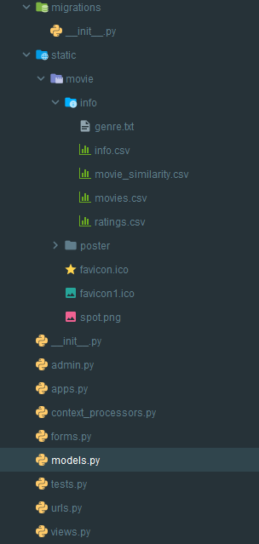
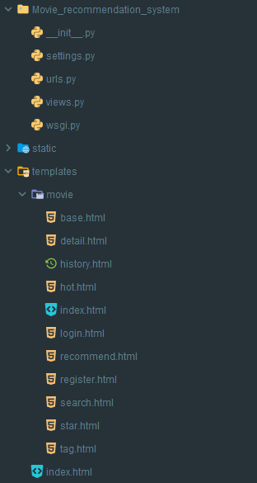
Project structure

Slide 6
Project structure
HEY
WAKE UP!
VITO
RAY
admin.py:
Function: Management backend configuration file, allowing application models to be managed in Django's automatically generated management backend.
Features: The backend management interface can be customized through simple code configuration, including registration models, field display, filters, etc.
apps.py:
Function: Application configuration file, used for metadata configuration of applications.
Features: You can configure the name, label and other metadata information of the application.
context_processors.py:
Function: Custom context processor for injecting specific context variables when rendering templates.
Features: These processors can make variables or functions used globally in templates available.
forms.py:
Function: Contains Django form classes for data validation and user interaction.
Features: These form classes can be automatically generated based on models or created manually for data validation and processing user input.
Dependencies: You can rely on models to define form fields, validate and save data.
DESIGNED BY IBOTU
DESIGNED BY IBOTU
DO SOME
THINGS!

Slide 7
Project structure
HEY
WAKE UP!
5.models.py：
Function: Contains Django models, which define the structure and relationships of data in the database.
Features: Models are used to define the data structure in the application and the relationships between models. The database can be operated through ORM (Object Relational Mapping).
Other parts, forms.py and views.py, can rely on these models to access and operate data in the database.
6.tests.py：
Function: Contains test code for unit testing.
7.urls.py：
Function: URL routing configuration file, which defines the mapping relationship between request URLs and view functions.
Features: Map URLs to corresponding view functions through regular expressions or path matching to implement request processing and response.
Dependencies: Contains view function names so that requests are dispatched to the correct view handler.
8.views.py：
Function: Contains Django view functions or classes that handle requests and generate responses.
Features: The view function receives the request and processes the logic. It can obtain data from the database, render the template, and then return the response to the user.
Dependencies: Depends on the model to obtain data and interact with the template.
9.settings.py：
Function: The settings file of the Django project, including the project configuration information.
VITO
RAY
DESIGNED BY IBOTU
DESIGNED BY IBOTU
DO SOME
THINGS!

Slide 8
Implementation process
HEY
WAKE UP!
VITO
RAY
1. Data collection and preparation stage:
Data set: MovieLens' ml-latest-small data set, about 600 users, about 9,700 movies, and 100,000 rating records.
Movie details: ml-latest-small provides a CSV file, which contains the ID number of the movie on IMDB.
2. Data storage and processing:
Django automatically generates relational mapping, uses models to define the structure and relationships of data in the database, and includes form-related Django form classes for user interaction and data validation.
3. Collaborative filtering algorithm selection and implementation:
UserCF is used for recommendation, and ItemCF calculates the similarity and is used in the similar movie column.
4. System architecture design and implementation:
Technology stack: The web framework uses Django, the database MySQL (MariaDB), HeidiSQL is used to operate the database, and the front-end uses bootstrap for rendering.
5. Test:
Register a user and the test results are as shown below
DESIGNED BY IBOTU
DESIGNED BY IBOTU
DO SOME
THINGS!

Slide 9
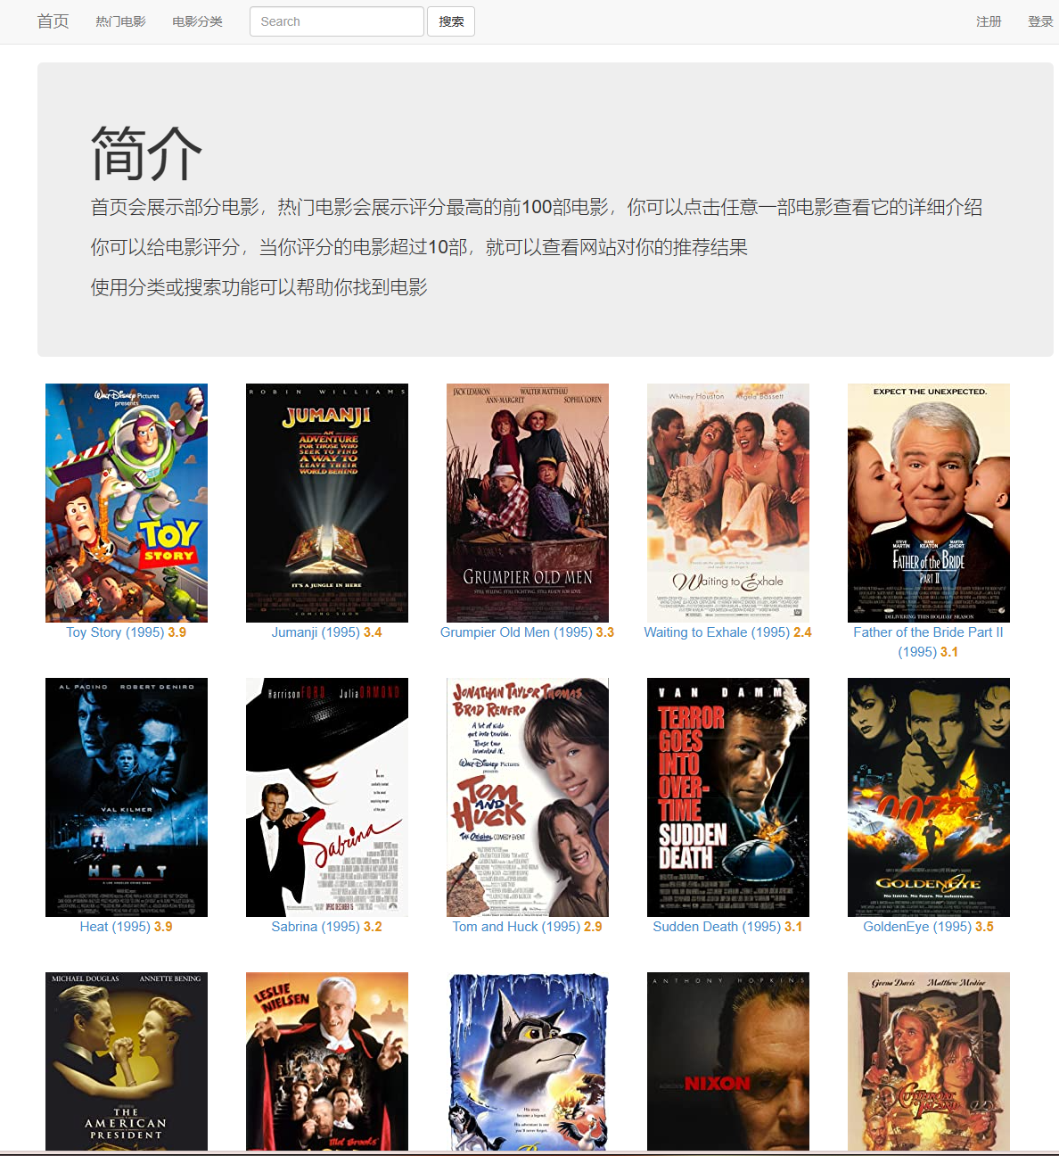
HEY
WAKE UP!
front page
Index
VITO
RAY
DESIGNED BY IBOTU
DESIGNED BY IBOTU
DO SOME
THINGS!

Slide 10
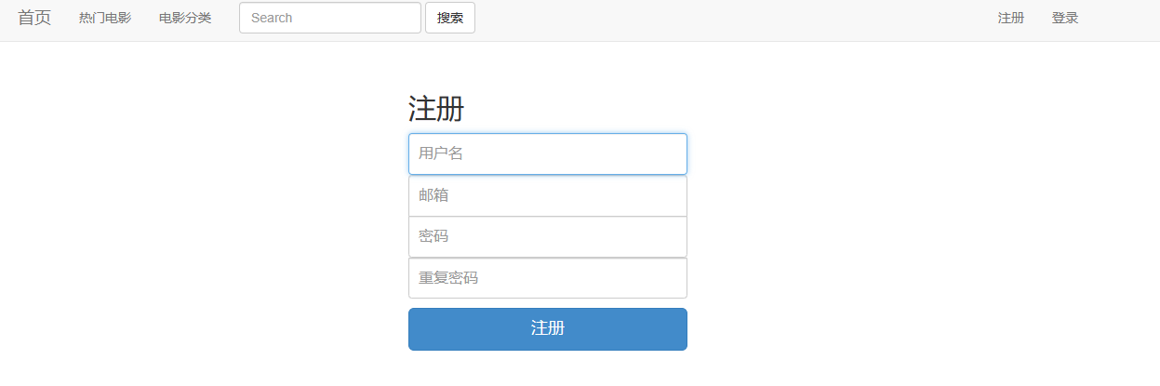
HEY
WAKE UP!
Register
VITO
RAY
DESIGNED BY IBOTU
DESIGNED BY IBOTU
DO SOME
THINGS!

Slide 11
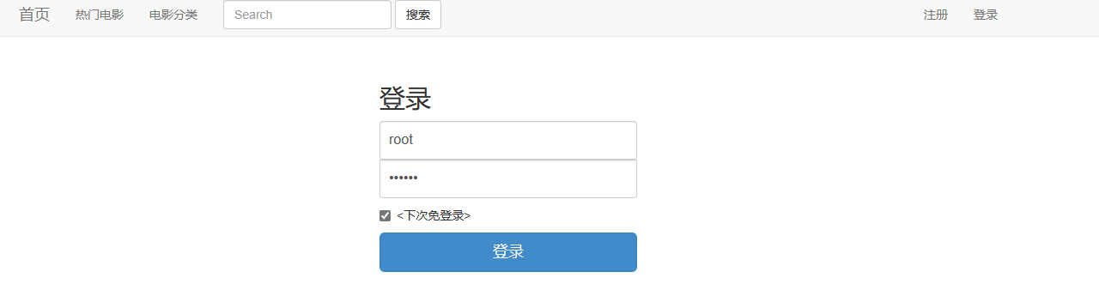
HEY
WAKE UP!
Login
VITO
RAY
DESIGNED BY IBOTU
DESIGNED BY IBOTU
DO SOME
THINGS!

Slide 12
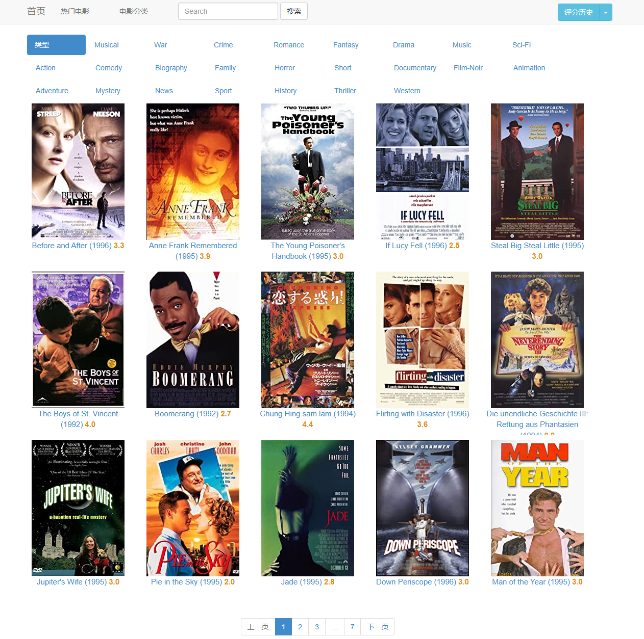
HEY
WAKE UP!
VITO
RAY
Movie categories
DESIGNED BY IBOTU
DESIGNED BY IBOTU
DO SOME
THINGS!

Slide 13
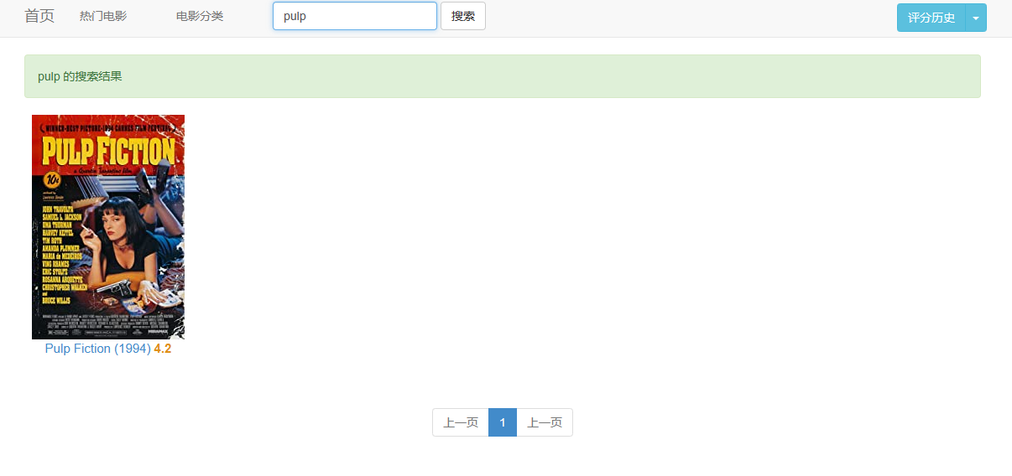
HEY
WAKE UP!
Search
VITO
Django comes with fuzzy query
RAY
DESIGNED BY IBOTU
DESIGNED BY IBOTU
DO SOME
THINGS!

Slide 14
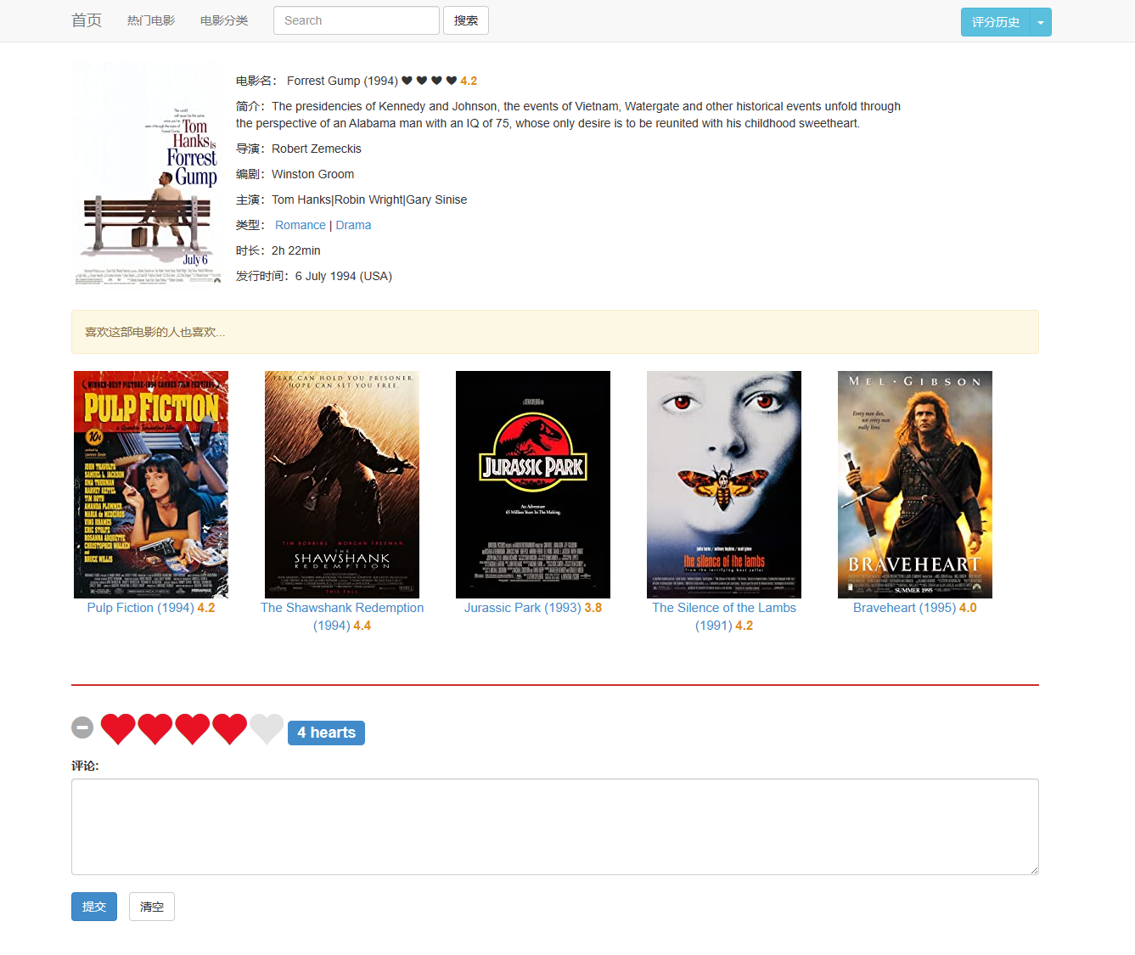
HEY
WAKE UP!
Rating
VITO
RAY
The following similar movie recommendations are implemented using the ItemCF algorithm
DESIGNED BY IBOTU
DESIGNED BY IBOTU
DO SOME
THINGS!

Slide 15
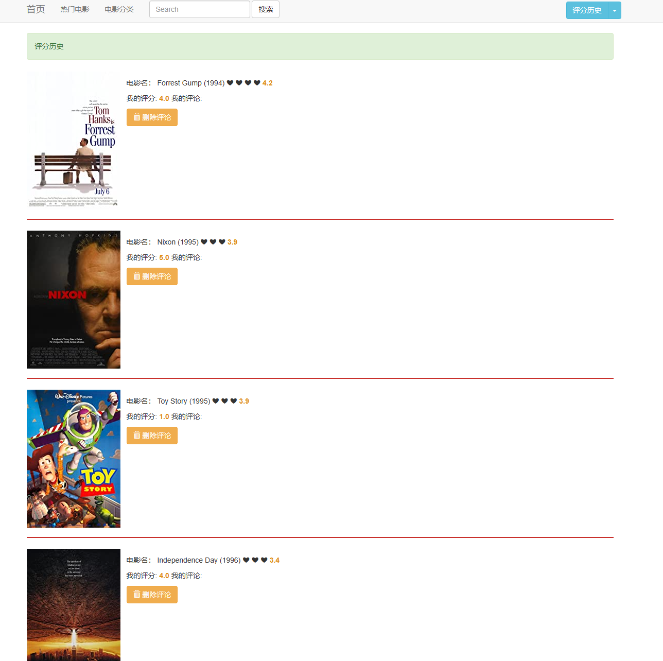
HEY
WAKE UP!
Rating history
VITO
RAY
DESIGNED BY IBOTU
DESIGNED BY IBOTU
DO SOME
THINGS!

Slide 16
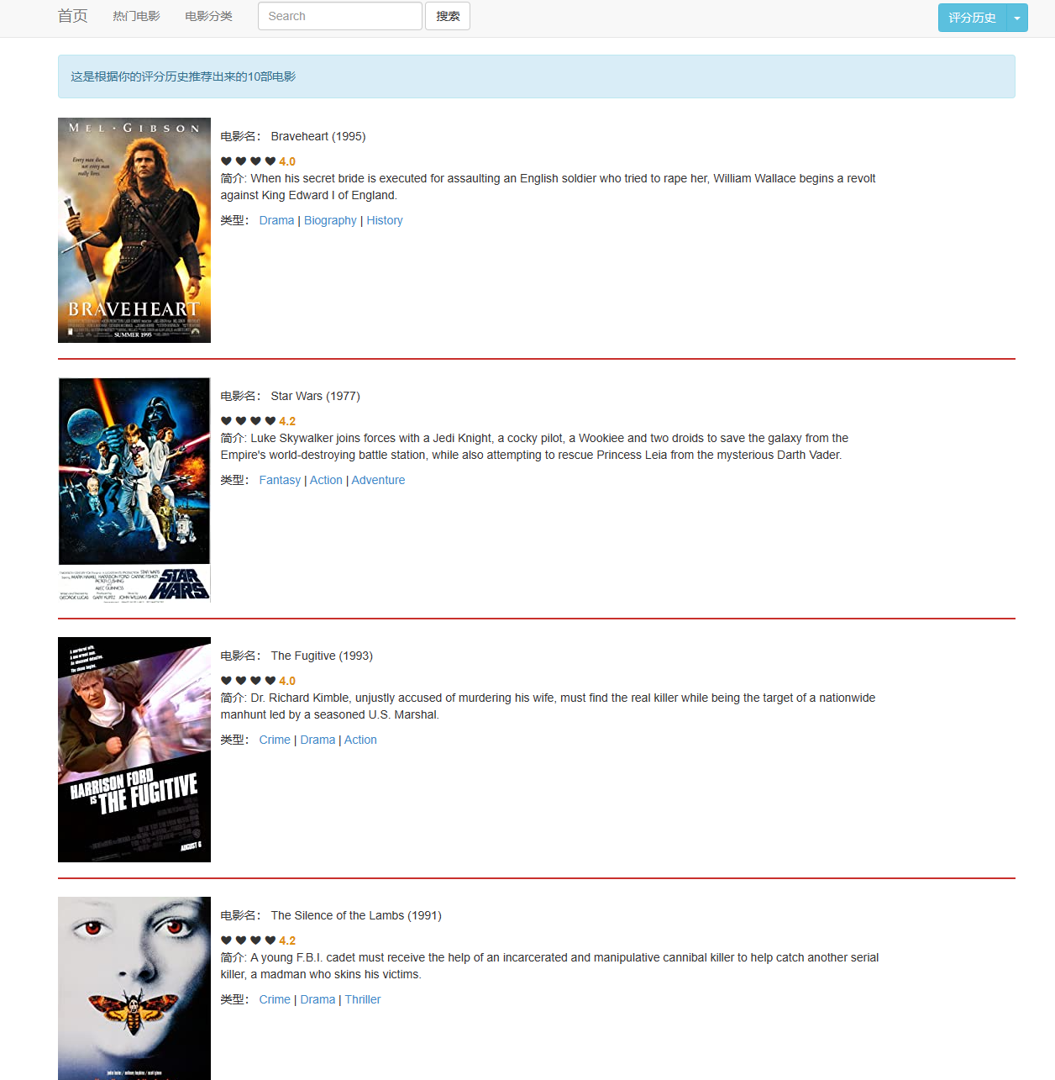
HEY
WAKE UP!
VITO
RAY
Recommended movies
Using UserCF algorithm to implement movie recommendation
DESIGNED BY IBOTU
DESIGNED BY IBOTU
DO SOME
THINGS!

Slide 17
UserCF algorithm
HEY
WAKE UP!
VITO
RAY
step: Find a set of users similar to the target user. Find items in this collection that users like and that the target user has not heard of, and then recommend them to the target user. shortcoming:
shortcoming: (1) In Internet application scenarios, the number of users is often much greater than the number of items, and UserCF needs to maintain a user similarity matrix to quickly find the Top n similar users. The storage overhead of this user similarity matrix is very large, and with the development of the business, the increase in the number of users will cause the storage space of the user similarity matrix to grow rapidly at a rate of n squared. This is an expansion speed that the online storage system cannot bear.
(2) User historical data vectors are often very sparse. For users with only a few purchases or clicks, the accuracy of finding similar users is very low, which makes UserCF unsuitable for applications where it is difficult to obtain positive feedback. Scenarios (such as hotel reservations, large-ticket purchase and other low-frequency applications).
Although collaborative filtering is a very intuitive and interpretable model, it does not have strong generalization capabilities. There is a serious problem - popular items have a strong head effect and are easy to be similar to a large number of items; while tail items have sparse feature vectors and are rarely similar to other items, resulting in them being rarely recommended.
Similar problems also occurred in the testing of this project. Popular movies have a high probability of appearing in recommended movies.
DESIGNED BY IBOTU
DESIGNED BY IBOTU
DO SOME
THINGS!

Slide 18
UserCF part
HEY
WAKE UP!
VITO
RAY
def get_user_sim(self): #获取与当前用户相似度最高的 K 个用户 # 用户相似度字典，格式为{ user_id1:val , user_id2:val , ... } user_sim_dct = dict() '''获取用户之间的相似度,存放在user_sim_dct中''' # 获取当前用户 cur_user_id = self.request.session['user_id'] cur_user = User.objects.get(pk=cur_user_id) # 获取其它用户 other_users = User.objects.exclude(pk=cur_user_id) self.cur_user_movie_qs = Movie.objects.filter(user=cur_user) # 计算当前用户与其他用户评分过的电影交集数 for user in other_users: # 记录感兴趣的数量 user_sim_dct[user.id] = len(Movie.objects.filter(user=user) & self.cur_user_movie_qs) # 按照key排序value，返回K个最相近的用户 print("user similarity calculated!") # 格式是 [ (user, value), (user, value), ... ] return sorted(user_sim_dct.items(), key=lambda x: -x[1])[:self.K]
DESIGNED BY IBOTU
DESIGNED BY IBOTU
DO SOME
THINGS!

Slide 19
UserCF part
HEY
WAKE UP!
VITO
RAY
def get_recommend_movie(self, user_lst): #基于相似用户列表，获取推荐的电影列表。 #遍历相似用户列表，获取这些相似用户评分过的电影，并根据用户评分，计算电影的兴趣值。 #返回按兴趣值排序的前N个电影。 # 电影兴趣值字典，{ movie:value, movie:value , ...} movie_val_dct = dict() # print(f'cur_user_movie_qs:{self.cur_user_movie_qs},type:{type(self.cur_user_movie_qs)}') # print(Movie.objects.all() & self.cur_user_movie_qs) # 用户，相似度 for user, _ in user_lst: # 获取相似用户评分过的电影，并且不在前用户的评分列表中的，再加上score字段，方便计算兴趣值 movie_set = Movie.objects.filter(user=user).exclude(id__in=self.cur_user_movie_qs).annotate( score=Max('movie_rating__score')) for movie in movie_set: movie_val_dct.setdefault(movie, 0) # 累计用户的评分 movie_val_dct[movie] += movie.score print('recommend movie list calculated!') return sorted(movie_val_dct.items(), key=lambda x: -x[1])[:self.N]
DESIGNED BY IBOTU
DESIGNED BY IBOTU
DO SOME
THINGS!

Slide 20
Some difficulties
HEY
WAKE UP!
VITO
RAY
I was not familiar with the front-end, so I encountered some difficulties when writing the page. I later improved it by finding some templates online, but the UI of the entire project was still a little rough.
DESIGNED BY IBOTU
DESIGNED BY IBOTU
DO SOME
THINGS!

Slide 21
HEY
WAKE UP!
VITO
RAY
2024/1/2
THANKS
DESIGNED BY IBOTU
DESIGNED BY IBOTU
A SIMPLE AND NICE TEMPLATE HOPE YOU LIKE BY VITO RAY
12119370118_何振宇
DO SOME
THINGS!

